Slide 1

Exploratory Data Analysis
G2M Insight for Cab Investment
July 2022

Slide 2
INTRODUCTION
Executive Summary
XYZ is a private equity firm in US. Due to remarkable growth in the Cab Industry in last few years and
multiple key players in the market, it is planning for an investment in Cab industry.
Problem Statement
Provide actionable insights to help XYZ firm in identifying the right company for making investment.
Below is the analysis for XYZ
Data Understanding
Cab company with high percentage profit
Recommendations for investment

Slide 3
APPROACH AND EDA
16 Features
Timeframe of the data : 2016/01/31 - 2018/12/31
Total data points : 348546
Assumptions
Price_Charged and Cost_of_Trip features are used to calculate profit.
The company feature contains two categorical values which are Yellow and Pink cab

Slide 4
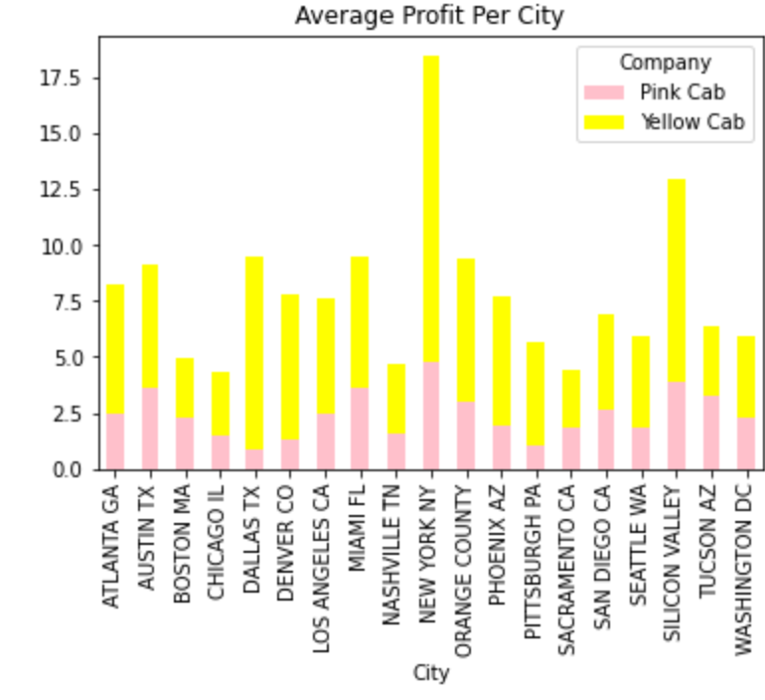
City profit Analysis
The chart shows a significant difference in profit between the two company. The Yellow cab recorded the highest profit average in New York City and Silicon Valley

Slide 5
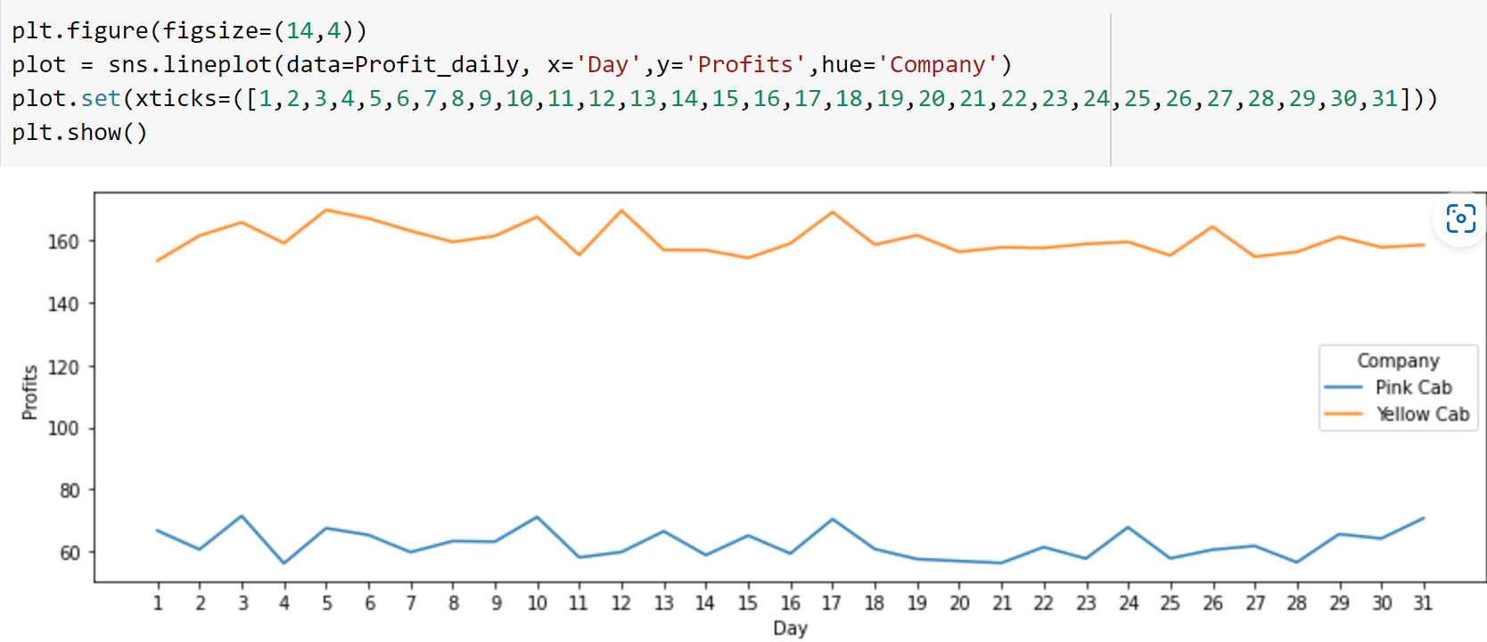
Day profit Analysis
The chart shows the increase and decrease of the daily profit. Yellow cab company makes more profit that pink cab company

Slide 6
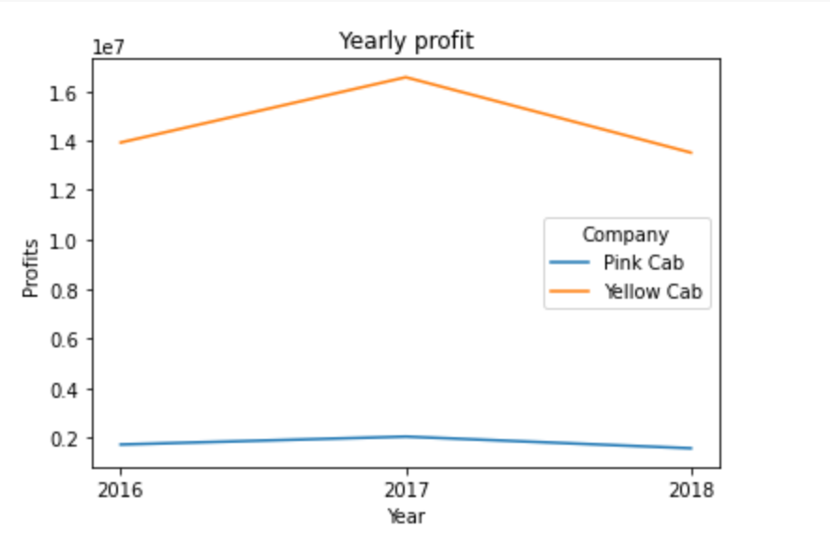
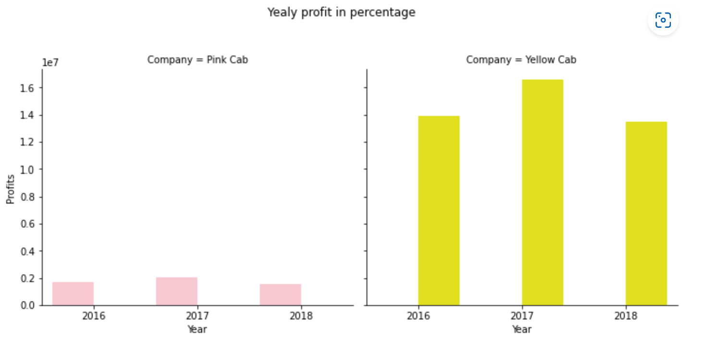
Yearly profit in Percentage
The Profit Percentage per year chart shows the Yellow Cab company earns more than the Pink Cab company
The chart shows a significant difference between the two company, with Yellow Cab coming out tops of the company.
The chart shows a difference in the profit margin between Yellow cab and Pink Cab. The two companies recorded their highest profit in 2017.
The record for the pink cab company is very poor

Slide 7
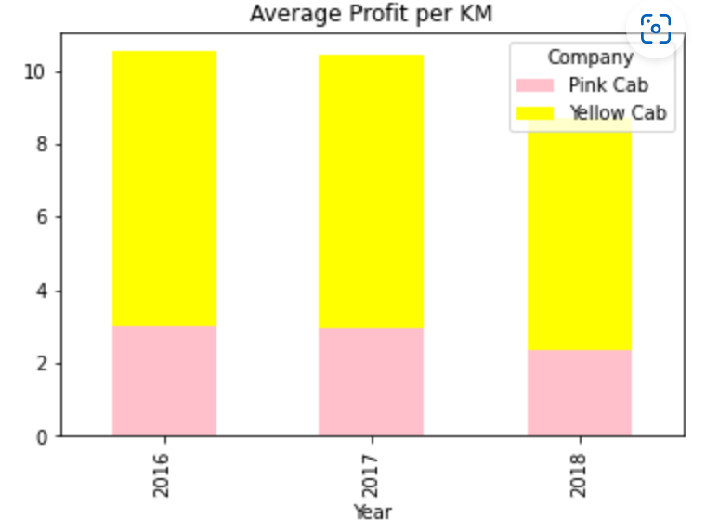
Average profit per KM
The Average Profit per year shows that there’s a huge profit margin per Kilometre between the 2 companies.

Slide 8
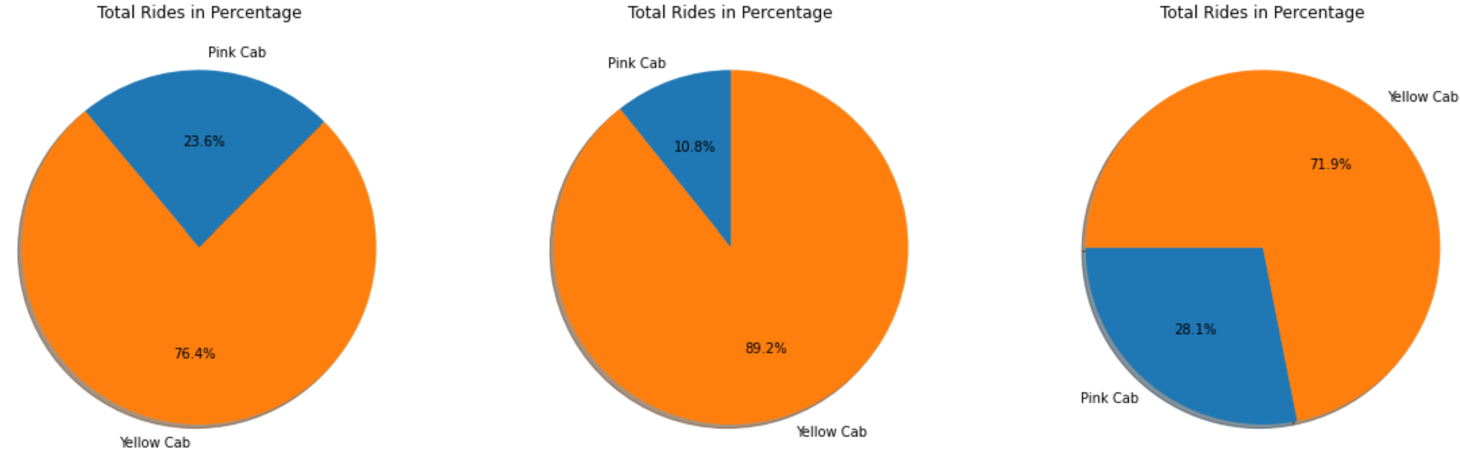
Total Ride

Slide 9
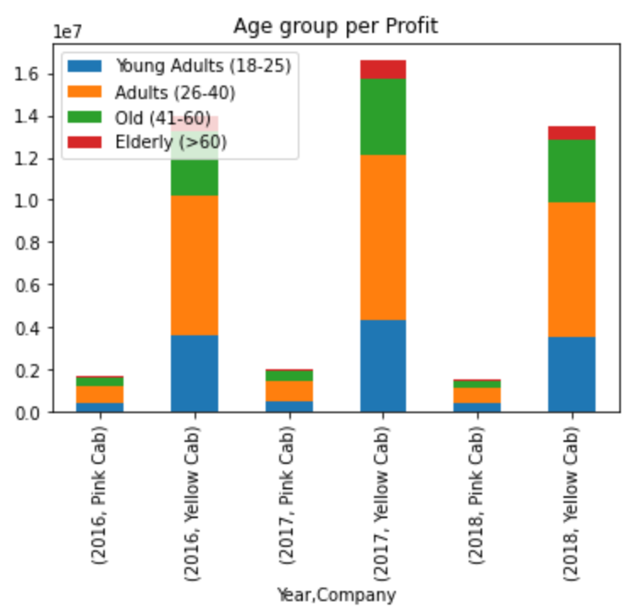
Age group Profit
The chart shows that majority of the profit generated by both companies are mostly from customers within the age of 26-40 years, followed by the 41-60 age category.

Slide 10
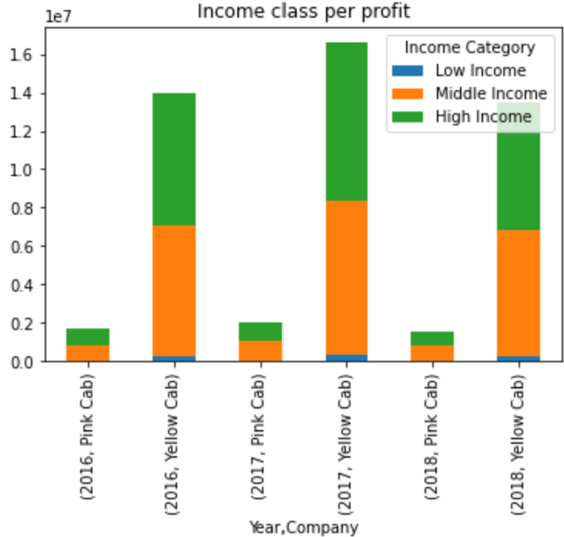
Profit in Income
The chart shows that majority of the profit generated by both companies are mostly from Middle and High income customers.

Slide 11
Summary / Conclusion
Profit analysis: Yellow cab company compared to pink has a larger percentage of total rides, percentage of total profit, and profit per ride.
Customer Base : Yellow cab has higher customer base in general across the US cities when compared to pink cab.
Average Profit per KM: Yellow cab’s average profit per KM is almost 3x times the average profit per KM of the Pink cab.
Income base: Yellow Cab Company generally reaches consumers from all income brackets, albeit at a lower rate than Pink Cab Company, which isn't the most popular option for lower income class.
Age group analysis: Both yellow and pink cab company showed similar trend in the age segments, with most of their customers falling between the ages of 26 and 40.
After successfully carrying out of analysis on Yellow and Pink Cab Company, I can boldly recommend the company that will bring high percentage of cash if XYZ private Investment company is to take the step of investing their money in the cab company. Base on the features that were evaluated, Yellow Cab company seems to have very high value in terms of Gender, City, Age group, Day profit, and Yearly profit than Pink Cab company.
Therefore, I strongly recommend that you should invest your money in Yellow cab company

Slide 12
Github Repo
Ovuowo-Rukevwe/G2M-insight-for-Cab-Investment (github.com)

Slide 13

G2M
Thank You

